Slide 1
PHARMACOLOGY
PROFESSOR S.O. OLAYEMI
Department of Pharmacology/Therapeutics/Toxicology
College of Medicine
University of Lagos Idi-araba
p

Slide 2

PHARMACOLOGY
Science dealing with drugs.
Divided into the following –
Pharmacokinetics
Pharmacodynamics
Pharmacotherapeutics
Chemotherapy
Toxicology

Slide 3
Routes of Drug Admistration
Oral Route (Enteral)
Sublingual (Perenteral) e.g Nitroglycerine
Transdermal Nitroglycerine, Nicotine
Nasal –Desmopressin
Inhalational route e.g Salbutamol, inhalational anaesthetics agents
Rectal route eg Rectal diazepam
Others Intravenous, Intramuscular,Subcutaneus, intradermal

Slide 4
PHARMACOLOGY
Pharmacokinetics and Pharmacodynamics- Goal of Therapeutics

Slide 5
INTRODUCTION
Goal of Therapeutics – to achieve a desired beneficial effect
Minimal adverse effects
Selecting the optimal dose requires adequate knowledge of the principles of Pharmacokinetics and Pharmacodynamics

Slide 6
Pharmacokinetics
Defined as time course of drug conc attained in different regions of the body during and after dosing
What the body does to the drug
Absorption
Distribution
Metabolism
Elimination

Slide 7
Pharmacokinetics
Deals with the dose conc relationship
Determines how rapid and for how long the drug will appear at the target organ
Absorption
Transfer of drug from the site of administration into the plasma

Slide 8
Factors influencing the rate and extent of absorption
Physicochemical factors of drug
Molecular weight
Degree of ionization under physiologic conditions
Product formulation characteristics
Disintegration and dissolution rates
Drug release characteristics for timed release prep

Slide 9
Factors influencing the rate and extent of absorption include:
Patient factors
Surface area available for absorption
Gastric and duodenal pH
Gastric motility
Bacterial colonization of the GI tract
Presence and extent of underlying disease
Presence of drug/food

Slide 10
Mech of transport across absorptive membrane
Passive diffusion – movement of drug molecules from region of relative high conc to low conc, no energy is required
Lipid soluble drugs traverse the membrane by dissolving in the lipid phase
Carrier mediated transport – carrier complexes with the drug and passes thru the membrane ad then returns, requires energy

Slide 11
Mech of transport across absorptive membrane
Facilitated transport – similar to carrier mediated but in addition a transport facilitator is required
Eg vit B12 attaches to an intrinsic factor and the complex attaches to a carrier molecule, does not require energy

Slide 12
Hepatic first pass effect
Loss of drug as it passes thru the liver for the first time
Significant reduction in bioavailability occurs
Hence a much larger dose is needed when given orally than when given thru other routes
Marked individual variations do occur – resulting in unpredictable absorption

Slide 13
Distribution
Definition
Distribution is the transport of a drug from the bloodstream to tissue sites where it will be effective, as well as to sites where the drug may be stored, metabolized, or eliminated from the body.
Vd is defined as the amt of drug in the body in relation to the conc of drug in plama

Slide 14
FACTORS AFFECTING DRUG DISTRIBUTION
After oral or parenteral admin, drugs are distributed non-uniformly throughout the body
Lipophilic characteristics of the drug- eg thiopentone highly lipid soluble drug distributes rapidly in the CNS
Blood supply to the tissues- highly perfused organs receive most of the drug.CNS/CVS/Renal
Plasma protein and tissue binding eg lipid soluble drugs may enter fat stores
Permeability across tissue barriers eg BBB

Slide 15
FACTORS AFFECTING DRUG DISTRIBUTION
Blood brain barrier – limit the entry of many drugs into the brain
Placental barrier – membrane separates fetal bld from maternal bld, lipid soluble drugs diffuse thru it readily

Slide 16
Apparent Volume of distribution
Vd = Amount of drug in the body
Plasma concentration.
If the dose of a drug given is 500 mg and it attains a uniform concentration of 10 mg/litre of plasma in the body its volume of distribution = 50 litres

Slide 17
Apparent volume of distribution
Drugs retained mostly plasma (aspirin, aminoglycosides) has small vd.
Drugs distributed into tissues (Pethidine) has wide vd
Poisoning/overdosage of drugs with wide vd cannot be remove with haemodiaysis.

Slide 18
FACTORS AFFECTING DRUG DISTRIBUTION
The distribution of drugs not only influence their onset of action but also sometimes their duration of action
Plasma protein binding – ensures that sufficient amt of drug reaches the receptors but not so much as to cause toxicity
Plasma albumin – high affinity for binding drugs so that only a portion of the total amt of drug is free
The bound drug does not exert any pharmacologic effect

Slide 19
Metabolism
Metabolism – defined as the enzyme catalyzed alteration of drugs by the individual
Involves conversion of lipid soluble drugs to water soluble ones so that they may be easily excreted by the kidneys
Two forms of metabolism:-
hepatic (major) and non hepatic

Slide 20
Metabolism
Hepatic drug metabolism
Liver cytochrome p-450 enzyme system – a collective term for a group of related enzymes or iso-enzymes
2 phases are involved
Phase I – altering to inactivate the drug pharmacologically or become more active or toxic - oxidation, demethylation etc

Slide 21
Metabolism
Phase II – conjugation reaction with glucuronic acid rendering the drug pharmacologically inactive and more polar
Example
Phenytoin – hydroxyphenytoin –phase I
Hphenytoin – penytoin glucuronide conjugate phase II

Slide 22
Factors modifying the metabolism of drugs
Presence of other drugs -Enzyme induction and inhibition from drug interaction
Pharmacogenetics – slow and fast acetylators of the anti TB drug INH
Liver disease – hepatic disease or dysfunction may impair drug elimination
Age – def in the new born – Chloramphenicol – gray syndrome, elderly more sensitive to cardiac glycosides

Slide 23
Enzyme Induction
drugs enhancing P450 cytochrome isoenzymes – Phenobarbitone, rifampicin,alcohol, cigarette smoke,DDT (environmental pollutants), griseofulvin,carbamazepine, phenytoin etc.

Slide 24
Relevance of Enzyme Induction
Therapeutic Failure
Toxicity –production of high amount of toxic intermediate metabolites
Tolerance of drugs eg carbamazepine autoinduction.
Disease process e.g antiepileptics enhancing vit D breakdown-osteomalacia
Variable response in those with alcohol/cigarette smoke

Slide 25
Therapeutic application of enzyme induction
Neonates/premature with deficiency of both microsomal and non-microsomal enzymes – administration of phenobarbitone helps in the rapid clearance of jaundice.

Slide 26
Enzyme Inhibition P450 enzymes
Drugs inhibiting P450 – cimetidine, ketoconazole, ciprofloxacin, verapamil, erythromycin and chloramphenicol.
They competively inhibit metabolism of endogenous substrate substances like testosterone and other drugs given concurently

Slide 27
Enyzme inhibition – non microsomal enzymes
Usually specific- ACE inhibitors (Lisinopril), Xanthine Oxidase inhibitors (Allupurinol), Monoamine Oxidase inhibitors (Selegiline), Phosphodiestarace inhibitors (Theophylline) and Cyclo-oxygenase inhibitors (NSAIDs)

Slide 28
Excretion of drugs
Kidney is main organ of excretion urine although others like sweat, saliva, bile faecal and pulmonary etc
Amt of drug that appears in urine depends on
Glomerular filtration rate
Tubular secretion
Tubular re-absorption

Slide 29
Excretion of drugs
Excretion of drugs from kidneys depend on
Lipid solubility – non-ionized lipid soluble drugs are not excreted but reabsorbed
Degree of ionization of drugs
PH of the urine – generally basic drugs are excreted in large quantities when the urine is acidic and vice versa

Slide 30
Excretion of drugs
Eg phenobarb poisoning is mgd by given sodium carbonate
amphetamine poisoning – ammonium chloride
Half life or elimination half life is the time req for its conc in the blood to be reduced by half
Most elimination follows first order reaction rather than zero order reaction

Slide 31
Clearance
Volume of plasma freed completely of the drug in the unit time.i.e Ratio of the rate of elimination to the plasma concentration
CL = Rate of elimination
Plasma conc
Expressed as ml/litre/unit time.

Slide 32
Pharmacodynamics
Focuses on the biochemical and physiological effect of drugs and the mech by which they produce such effects
Governs the conc-effect part of the interaction relationship (dose-response)
Determines the magnitude of the effect at a particular conc

Slide 33
Pharmacodynamics
Systemically active drugs must enter and be transported by body fluids
The drugs must pass various barriers, escape excessive distribution into sites of loss and penetrate to the active site
Orient themselves and interact with receptors to alter function

Slide 34
Pharmacodynamics
The drug must then be removed from the active site and metabolized to a form that is easily excreted by the body
Drug action results from interaction with receptors – proteins, enzymes, cell lipids, or pieces of DNA or RNA

Slide 35
Pharmacodynamics
What are receptors?
Small parts of proteins that control a multitude of chemical reactions and functions in the body.
Receptors have a specific, chemical structure compatible only with certain drugs or endogenous compounds—substances that originate within the body such as hormones and neurotransmitters

Slide 36
Pharmacodynamics
Drug actions are a result of the dynamic interactions btw drug molecules and cellular components called receptors
Receptor agonists – drug that interacts with receptors and elicit a response
Receptor antagonist – drugs that interact with receptors and prevents the action of an agonist

Slide 37
Pharmacodynamics
Potency – a measure of dosage required to bring about a response
Efficacy – a measure of a drugs inherent ability to exert an effect
Dose response relationship – a relationship btw the amt of drug admin and the magnitude of desired response

Slide 38
A hypothetical dose-response curve has features that vary :
POTENCY (location of curve along the dose axis)
MAXIMAL efficacy or ceiling effect (greatest attainable response)
SLOPE (change in response per unit dose).

Slide 39
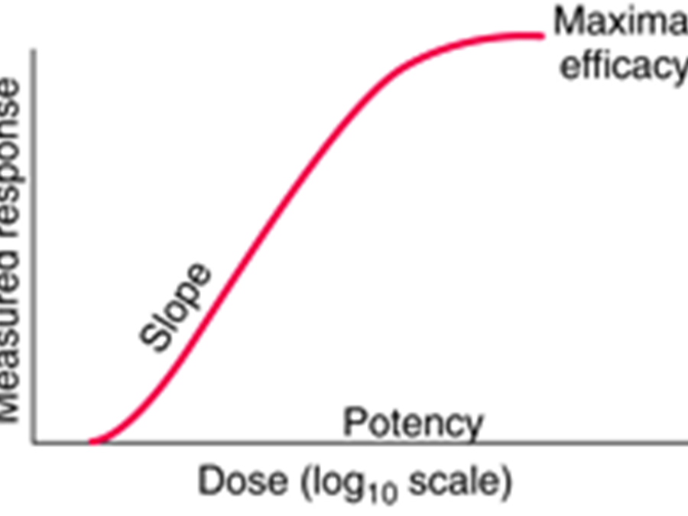
SINGLE DRUG-DOSE RESPONSE

Slide 40
BIOLOGIC VARIATION
variation in magnitude of response among test subjects in the same population given the same dose of drug also occurs.

Slide 41
Graphing dose-response curves of drugs studied under identical conditions can help compare the pharmacologic profiles of the drugs
This is done by comparison of dose-response curves.
This information helps determine the dose necessary to achieve the desired effect

Slide 42
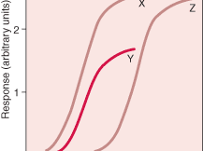
COMPARISM OF DRUGS

Slide 43
The therapeutic index (ratio of the minimum toxic concentration to the median effective concentration) helps determine the efficacy and safety of a drug.
Increasing the dose of a drug with a small therapeutic index increases the probability of toxicity or ineffectiveness of the drug

Slide 44
However, these features differ by population and are affected by patient-related factors
PREGNANCY
AGE -elderly,neonates,children
ORGAN FUNCTION -estimated GFR

Slide 45
Pharmacodynamics
Therapeutic index – deals with the ratio of lethal doses to 50% of the population (LD50) over the median minimum effective dose (ED50)
The higher the TI the safer the drug, the lower the TI the greater the possibility of toxicity eg Cardiac glycosides have very low TI and death may result if 3mg is admin as against their usual dose of 1mg

Slide 46
Mech of drug action
Interaction with receptors – propranolol acting on beta receptors on the heart
Interaction with enzymes
eg allopurinol lowers uric acid by inhibiting xanthine oxidase enzyme

Slide 47
Mech of drug action
Interaction with nucleic acid- 6-mercaptopurine inhibits purine ring biosynthesis, alkylating agents cross link DNA
Inhibition of protein synthesis – antibiotic eg tetracycline, erythromycin etc
Interaction with cell membranes – cardiac glycoside inhibit Na+/K+ ATPase pump in the cell membrane inhibiting Na+ outflow; local anesthetics block impulse conduction in nerve cell membranes by interfering with membrane permeability to Na+ and K+

Slide 48
General characteristics of dosage forms
Systemic dosage forms
  oral (mixture, syrup, tablet (coated, slow-release), powder, capsule)
  sublingual (tablet, aerosol)
  rectal (suppository)
  inhalation (gases, vapour)
  injections (subcutaneous, intramuscular, intravenous, infusion)

Slide 49
General characteristics of dosage forms
Local dosage forms
  skin (ointment, cream, lotion, paste)
  sense organ (eye drops/ointment, ear drops, nose drops)
  oral/local (tablets, mixture)
  rectal/local (suppository, enema)
  vaginal (tablet, ovule, cream)
  inhalation/local (aerosol, powder)

Slide 50
General characteristics of dosage forms
Oral forms
efficacy:(-) uncertain absorption and first-pass metabolism, (+) gradual effect
safety:(-) uncertain absorption, gastric irritation
convenience:(-)? handling (children, elderly)
Sublingual tablets and aerosols
efficacy:(+) act rapidly, no first-pass metabolism
safety:(-) easy overdose
convenience:(-) aerosol difficult to handle, (+) tablets easy to use

Slide 51
General characteristics of dosage forms
Rectal preparations
efficacy:(-) uncertain absorption, (+) no first-pass metabolism, rapid effect
safety:(-) local irritation
convenience:(+) in case of nausea, vomiting and problems with swallowing
Inhalation gases and vapours
efficacy:(+) fast effect
safety:(-) local irritation
convenience:(-) need handling by trained staff

Slide 52
General characteristics of dosage forms
Injections
efficacy:(+) fast effect, no first-pass metabolism, accurate dosage possible
safety:(-) overdose possible, sterility often a problem
convenience:(-) painful, need trained staff, more costly than oral forms
Topical preparations
efficacy:(+) high concentrations possible, limited systemic penetration
safety:(-) sensitization in case of antibiotics, (+) few side effects
convenience:(-) some vaginal forms difficult to handle

Slide 53
Kind of Drug Dosage
Fixed Dose e.g PCM 500mg to 1000mg 6 hourly is the usual adult dose
Individualised Dose- low safety margin drugs dosage has to tailored to the needs of patients in CKD- e.g digoxin.
Loading dose – administered single large dose/series of quickly doses given rapidly to attain target conc.
Maintenance dose – maintain the drug level

Slide 54
Therapeutic Drug Monitoring
Indications
Use of drugs with low safety margin
To reduce the risk of toxicity e.g Nephrotoxic drugs in CKD
Treatment of poisoning
Unexplainable therapeutic failure
Checking patient compliance
No reliable methods to assess benefit e.g TCAs.

Slide 55
THANK YOU
FOR LISTENING

